Slide 1
E-Commerce Software
SE-413
Week 6

Slide 2
Web Hosting
Self-hosting is running servers in-house
Most often used by large companies
Third-party Web-hosting service providers offer Web services, electronic commerce functions
Often used by midsize, smaller companies
Commerce service providers (CSPs) provide Internet access and Web-hosting services
Offer Web server management and rent application software
Also called Managed service providers (MSPs) or Application service providers (ASPs)

Slide 3
Web Hosting
Web-hosting service options
Shared hosting means client's Web site on a server hosting other Web sites simultaneously
Dedicated hosting means the client Web server not shared with other clients
Service provider owns and maintains server hardware, leases it to client, and provides Internet
With co-location (collocation or colocation) service the provider rents physical space to client with a reliable power supply, Internet connection
Clients install/maintain server hardware and software

Slide 4
Web Hosting
Web server-hosting decisions
Hardware platform and software combination
Should be upgradable when site’s Web traffic increases
Scalable hardware and software combinations
Adaptable to meet changing requirements

Slide 5
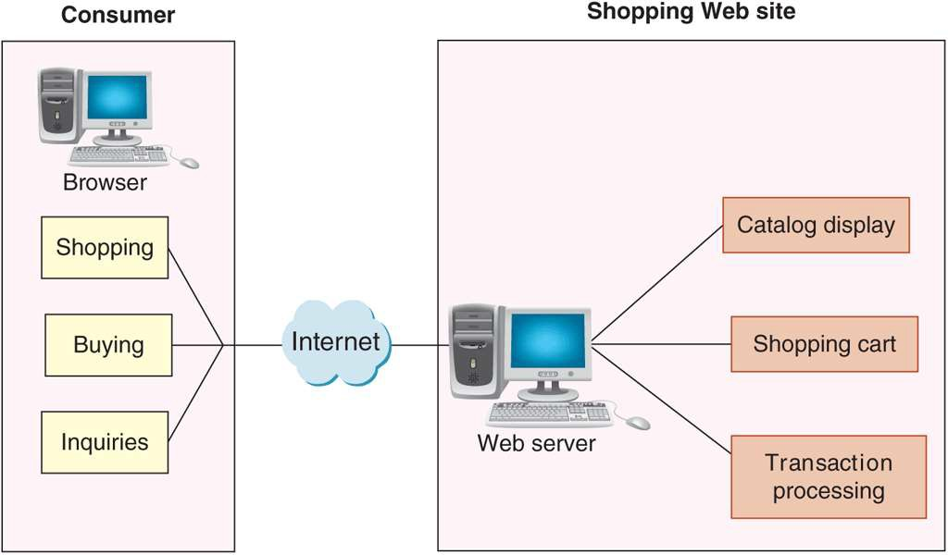
Basic Functions of Electronic Commerce Software
All electronic commerce solutions must provide
Catalog display, shopping cart capabilities and transaction processing
Larger complex sites may include software with added features and capabilities

Slide 6
Catalog Display
Catalog organizes goods and services being sold
Web store advantage is a single product may appear in multiple categories
Static vs Dynamic Catalog

Slide 7
Shopping Cart
Early electronic commerce used forms-based shopping
Keep track of items customer selected and allows them to view cart contents, add and remove items
Ordering requires a simple click which executes the purchase transaction
Billing and shipping information is part of shopping cart.
Use Cookies to hold information

Slide 8
Transaction Processing
Occurs when shopper proceeds to virtual checkout counter by clicking the checkout button
Calculates total amounts and processes coupons, promotions, time-sensitive offers
Web browser and seller’s Web server software switch into secure communication state
Involves accounting, sales and inventory modules
Shipping rate software integration

Slide 9
Additional Features
Work in tandem with Shopping cart and Catalog Display
Dynamic Price Management
Promotion Management
Fulfillment Integration
Product Review
Product Recommendation
Abandoned Cart Management

Slide 10
Part of a Larger Picture
Many large companies also have substantial business activity unrelated to electronic commerce
Important to integrate electronic commerce activities into the company’s other operations

Slide 11
Middleware
Sits between Ecommerce Software and Other software
Acts as a bridge and translator between two software.
For example : Takes sales and inventory shipments information and copies it to accounting and inventory management software.
Custom made vs Commercial
More commercial software are enabling Interoperability.

Slide 12
Enterprise Application Integration
Application Server and Software
EAI is creation of links among scattered applications so business logic can be interconnected
Same network or different network
XML or JSON is commonly used
Single Page application vs Component Based (Example: MVC)
ERP integration is single point
ERP Giants: Oracle, SAP, Microsoft
Middle size ERPs: NetSuite or other SaaS

Slide 13
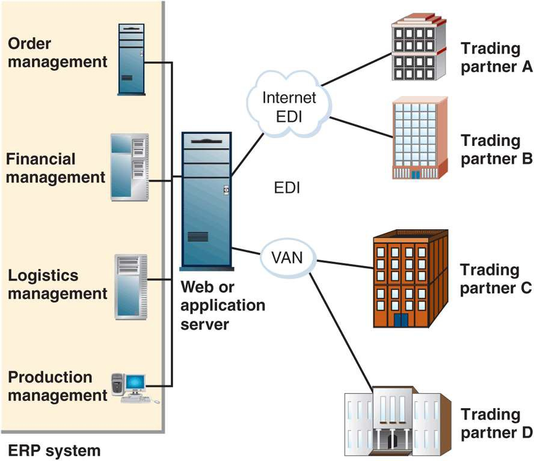
ERP Integration

Slide 14
Web Services
Application program interface (API) is a way to make a functionality of an application available to other programs
Web Service is an API that is build upon web standards.
Always over a network
Service Description
SOAP, HTTP, XML-RPC
Advantages:
Allows communication between application that are differently built or differently located.

Slide 15
Web Services (SOAP)
Simple Object Access Protocol (SOAP) is a message-passing protocol
Communication based on SOAP specification
Web Services Description Language (WSDL)
Describes logic unit characteristics of each Web service
Universal Description, Discovery, and Integration Specification (UDDI)
Identify Web services locations and associated descriptions
UDDI Registries

Slide 16
REST and RESTful Design
Representational State Transfer (REST)
Stateless mechanism for transferring data or serving requests.
RESTful design (RESTful applications) are Web services built on the REST model
More than half of all Web services today are RESTful applications
HTTP APIs are widely used.

Slide 17
Commerce Service Providers
Use of service provider’s shared or dedicated hosting services
Shifts staffing burden from company to Web host
Spread costs over all hosted businesses
Host provider keeps server working through storms and power outages
CSPs offer free or low-cost e-commerce software
Less than $20 per month with software built into site
CSP examples
Wordpress.com

Slide 18
Mall Style CSP
Provide small businesses with Web site, online store design tools, templates and easy-to-use interfaces
Low monthly fee, one-time setup fees and percentage (or fixed) amount for each transaction
Integrated Shopping cart software and payment processing
Examples:
Daraz.pk, Ebay

Slide 19
Mid Size CSP
Normally includes:
Basic and advanced modules.
Setup Wizards, Theme Customizations, Data Connectivity etc.
Example:
Shopify

Slide 20
Enterprise CSP
Provide E-Commerce functionality as part of a larger software.
Example
Salesforce Commerce Cloud
SAP Commerce
MS Sharepoint

